Slide 1
Homework 10 Customer Movement
MR.KITTISAK SUPUTTHORN
ID NO. 6220422014
BADS 7105 CUSTOMER RELATIONSHIP MANAGEMENT ANALYTICS AND INTELLIGENCE

Slide 2
APPROACH
Customer Movement Analysis
Cohort Tables
Successful recruitment of new customers is only truly successful if they return to buy from you again.

Slide 3

DATA SET: dunnhumby's Shopper

Slide 4
DATA SET DETAILS

Slide 5



PROCESS
First
Prepare dataset
Second
Calculate Customer Movement using Google bigquery
Last
visualize result in google data studio

Slide 6
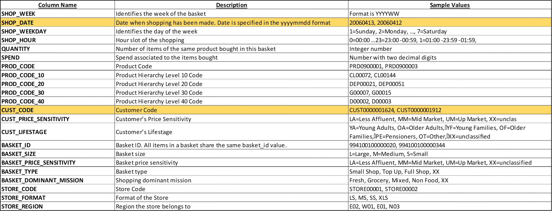
Prepare data

Slide 7
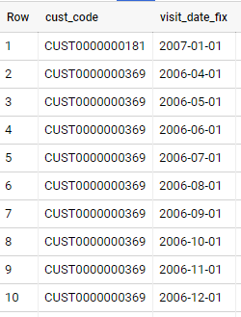
Table: visit by Month
visit_log AS(
SELECT
cust_code,
DATE_TRUNC(PARSE_DATE('%Y%m%d',
CAST(shop_date AS STRING)), MONTH) AS visit_date_fix
FROM
`bads7105-crm-312814.supermarket_dataset.transitions`
WHERE
cust_code IS NOT NULL
AND cust_code != ''
GROUP BY
1,
2
ORDER BY
1,
2)

Slide 8
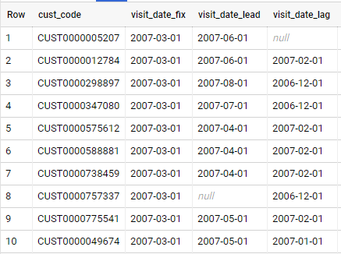
Table: Time lapse
Time_lapse AS(
SELECT
cust_code,
visit_date_fix,
LEAD(visit_date_fix, 1) OVER (PARTITION BY cust_code
ORDER BY cust_code, visit_date_fix) AS visit_date_lead,
LAG(visit_date_fix, 1) OVER (PARTITION BY cust_code
ORDER BY cust_code, visit_date_fix) AS visit_date_lag
FROM
visit_log)

Slide 9
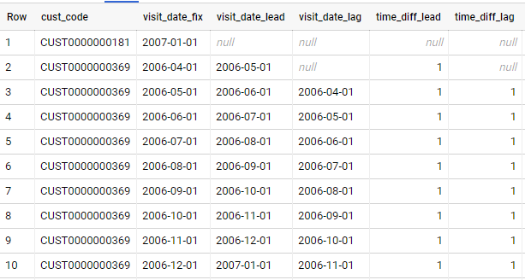
Table: Time diff
Time_diff_calculated AS(
SELECT
cust_code,
visit_date_fix,
visit_date_lead,
visit_date_lag,
DATE_DIFF(visit_date_lead, visit_date_fix, MONTH) AS time_diff_lead,
DATE_DIFF(visit_date_fix, visit_date_lag, MONTH) AS time_diff_lag
FROM
time_lapse
ORDER BY
1,
2)

Slide 10
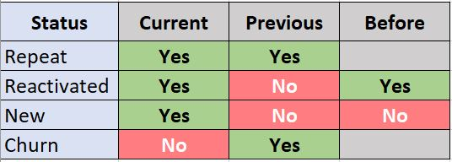
Customer status
New Customer - Customer who never appeared in the previous months(first purchase).
Reactivated Customer - Customers who bought then disappear. The previous month did not appear but come back and buy in this month
Repeat Customer - Customers who bought last month and still buy in this month.
Churn Customer - Customers who bought last month but this month did not appear.

Slide 11
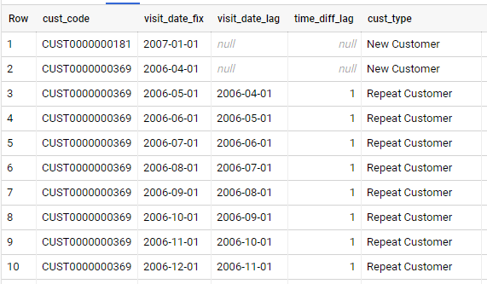
Table: categorized lag
Custs_categorized_lag AS(
SELECT
cust_code,
visit_date_fix,
visit_date_lag,
time_diff_lag,
CASE
WHEN time_diff_lag =1 THEN 'Repeat Customer'
WHEN time_diff_lag >1 THEN 'Reactivated Customer'
WHEN time_diff_lag IS NULL THEN 'New Customer'
ELSE
'n/a'
END
AS cust_type
FROM
Time_diff_calculated)

Slide 12
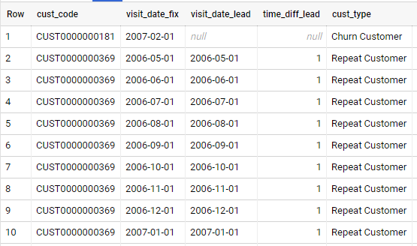
Table: categorized lead
Custs_categorized_lead AS(
SELECT
cust_code,
DATE_ADD(visit_date_fix, INTERVAL +1 MONTH) AS visit_date_fix,
visit_date_lead,
time_diff_lead,
CASE
WHEN time_diff_lead =1 THEN 'Repeat Customer'
ELSE
'Churn Customer'
END
AS cust_type
FROM
Time_diff_calculated)

Slide 13
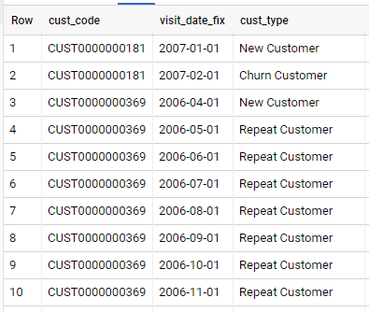
Table: Summary
Summary AS(
SELECT
cust_code, visit_date_fix, cust_type
FROM
Custs_categorized_lag
UNION DISTINCT
SELECT
cust_code, visit_date_fix, cust_type
FROM
Custs_categorized_lead
WHERE
cust_type = 'Churn Customer'
ORDER BY
1,
2)

Slide 14
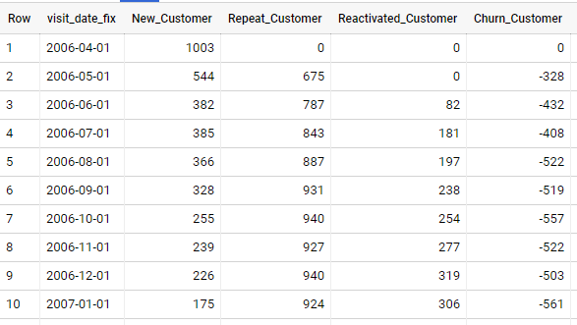
Get final result
SELECT
visit_date_fix,
COUNT(DISTINCT CASE WHEN cust_type = 'New Customer' THEN cust_code
END) AS New_Customer,
COUNT(DISTINCT CASE WHEN cust_type = 'Repeat Customer' THEN cust_code
END) AS Repeat_Customer,
COUNT(DISTINCT CASE WHEN cust_type = 'Reactivated Customer' THEN cust_code
END) AS Reactivated_Customer,
-COUNT(DISTINCT CASE WHEN cust_type = 'Churn Customer' THEN cust_code
END) AS Churn_Customer
FROM
Summary
WHERE
visit_date_fix != '2008-08-01'
GROUP BY
visit_date_fix
ORDER BY
visit_date_fix

Slide 15
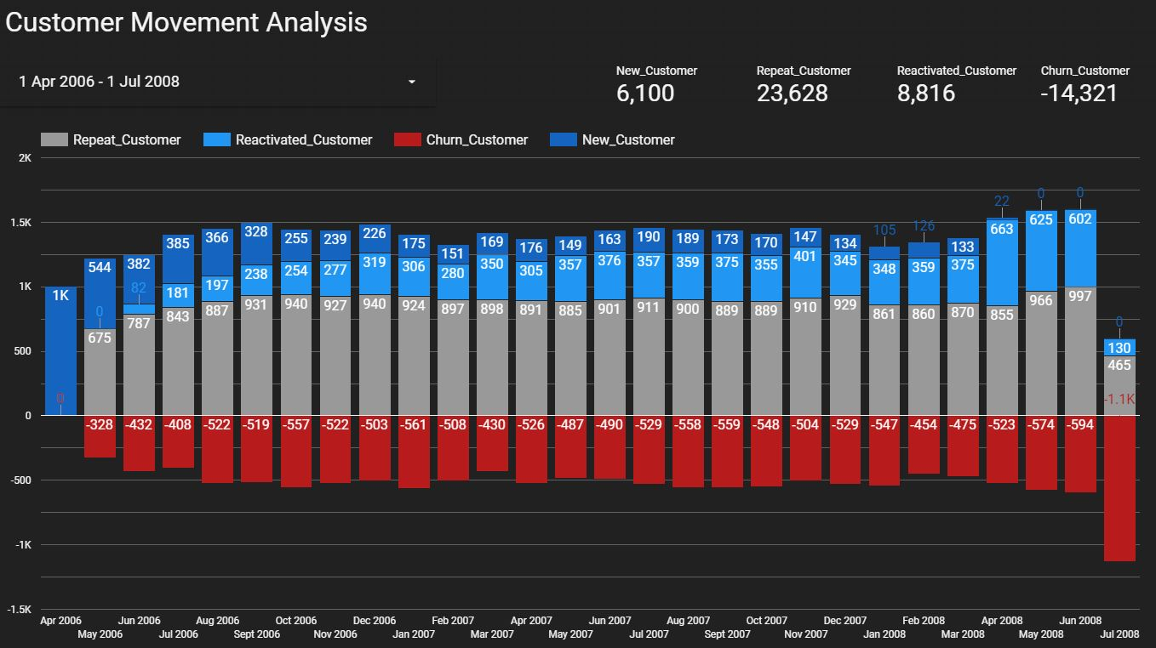
Visualization

Slide 16
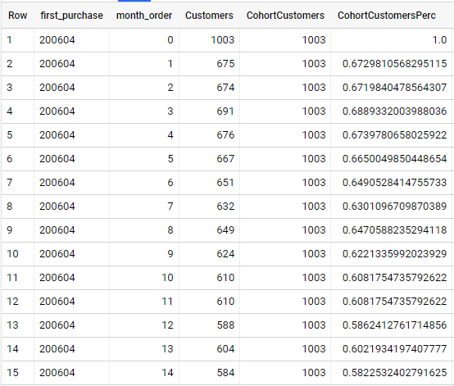
Cohort table
WITH t_first_purchase AS (
SELECT date, DATE_DIFF(date, first_purchase_date, MONTH) AS month_order,
FORMAT_DATETIME('%Y%m', first_purchase_date) AS first_purchase, CUST_CODE
FROM (SELECT PARSE_DATE('%Y%m%d', CAST(SHOP_DATE AS STRING)) AS date,
CUST_CODE,FIRST_VALUE(PARSE_DATE('%Y%m%d', CAST(SHOP_DATE AS STRING))) OVER (PARTITION BY CUST_CODE ORDER BY PARSE_DATE('%Y%m%d', CAST(SHOP_DATE AS STRING))) AS first_purchase_date
FROM `bads7105-crm-312814.supermarket_dataset.transitions`
WHERE cust_code IS NOT NULL AND cust_code != '')),
t_agg AS (SELECT first_purchase,month_order,COUNT(DISTINCT CUST_CODE) AS Customers
FROM t_first_purchase
GROUP BY first_purchase, month_order),
t_cohort AS (SELECT *,SAFE_DIVIDE(Customers, CohortCustomers) AS CohortCustomersPerc
FROM (SELECT *,FIRST_VALUE(Customers) OVER (PARTITION BY first_purchase ORDER BY month_order) AS CohortCustomers
FROM t_agg
))
SELECT * FROM t_cohort
ORDER BY first_purchase, month_order

Slide 17

Visualization

Slide 18
Thanks!

